Slide 1
ROCKBUSTER STEALTH LLC
Business Insights
Rockbuster LLC. | Tableau Public
Haarika Mahankali
March 2022

Slide 2
Motive: Rockbuster Stealth management team is planning to use its existing movie licenses to launch an online video rental service in order to stay competitive in today’s world.
Key Questions and Objectives:
To help develop the launch strategy for the new online video service, below are the key questions asked by the management board:
Which movies contributed the most/least to revenue gain?
What was the average rental duration for all videos?
Which countries are Rockbuster customers based in?
Where are customers with a high lifetime value based?
Do sales figures vary between geographic regions?

Slide 3
There are 1000 movies that are available from Rockbuster Stealth which are all in English. Below are the minimum, maximum and average cost, payment and rental duration for all the movies.
 | Min | Max | Avg
Rental Payment | $0 | $11.99 | $4.2
Rental Duration | 3 days | 7 days | 4.9 days
Rental Rate | $ 0.99 | $ 4.99 | $ 2.98
Replacement Cost | $ 9.99 | $ 29.99 | $ 19.98
The film title, Telegraph Voyage, has brought highest revenue of $215.75. It is a Musical
The film title, Duffel Apocalypse, has brought the least revenue of $5.94. It is from Documentary Genre

Slide 4
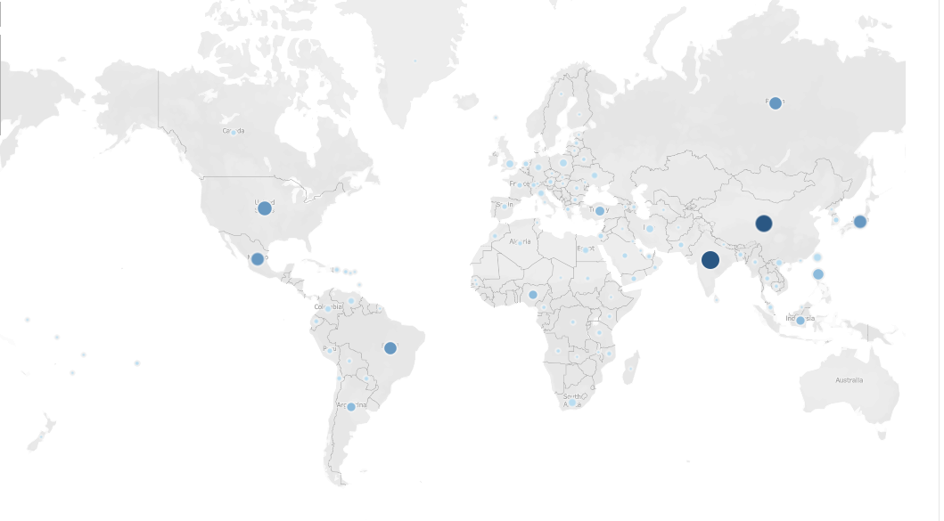
A total of 599 customers are spread throughout the world. Rockbuster Stealth has customers in 108 countries.
Around 45% of all the customers are from Asia with India leading with 60 customers
83 countries have 5 or less number of customers each

Slide 5
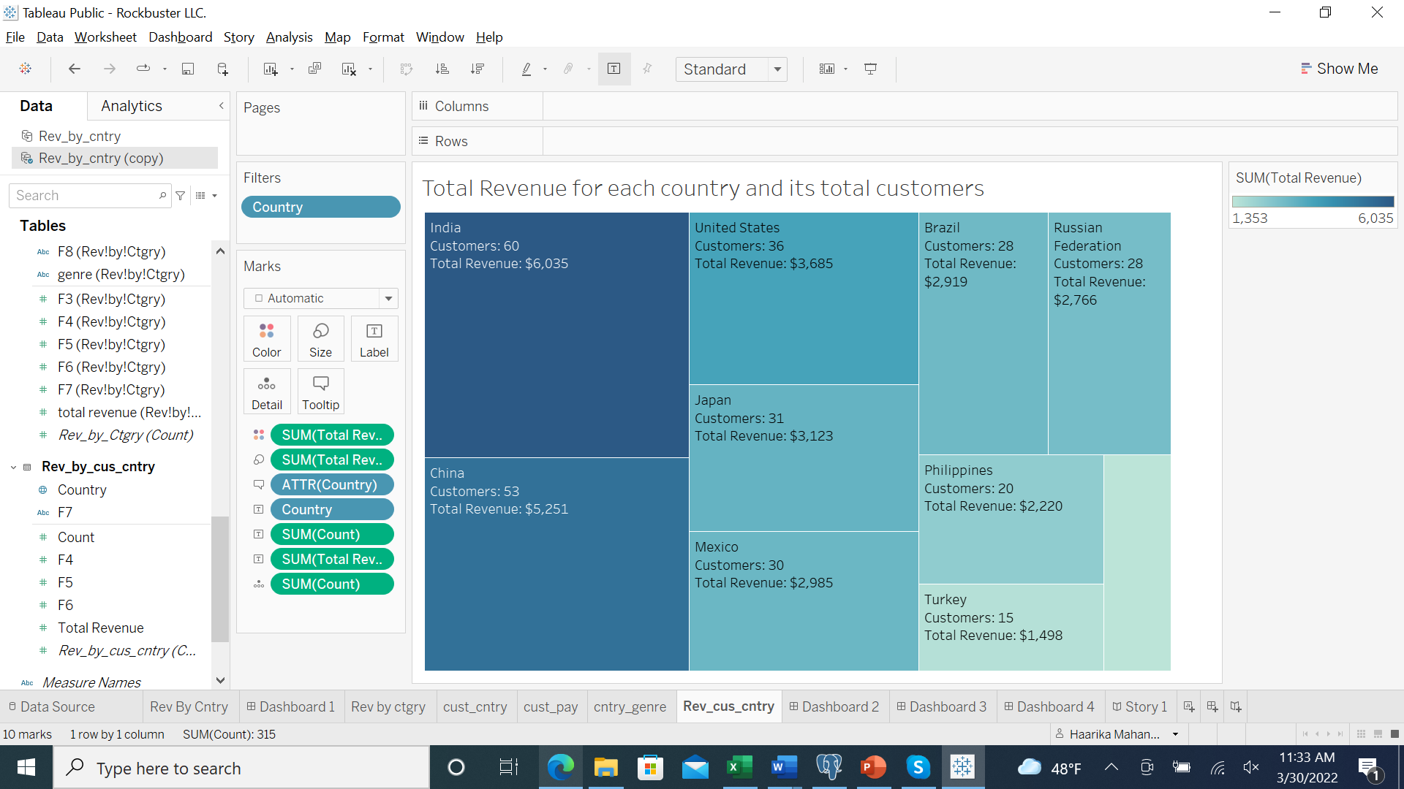
Top 10 countries for Rockbuster in terms of customer numbers

Slide 6
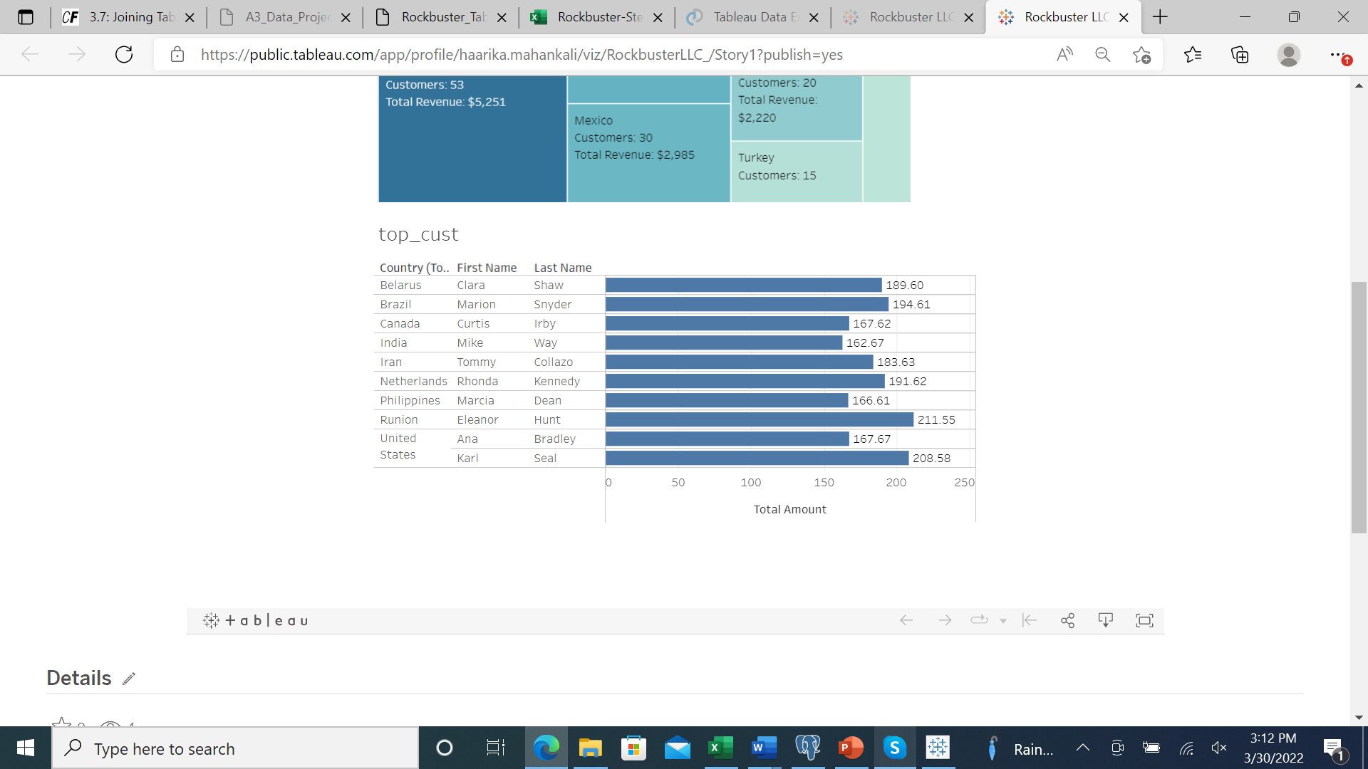
Top 10 customers with highest payments

Slide 7
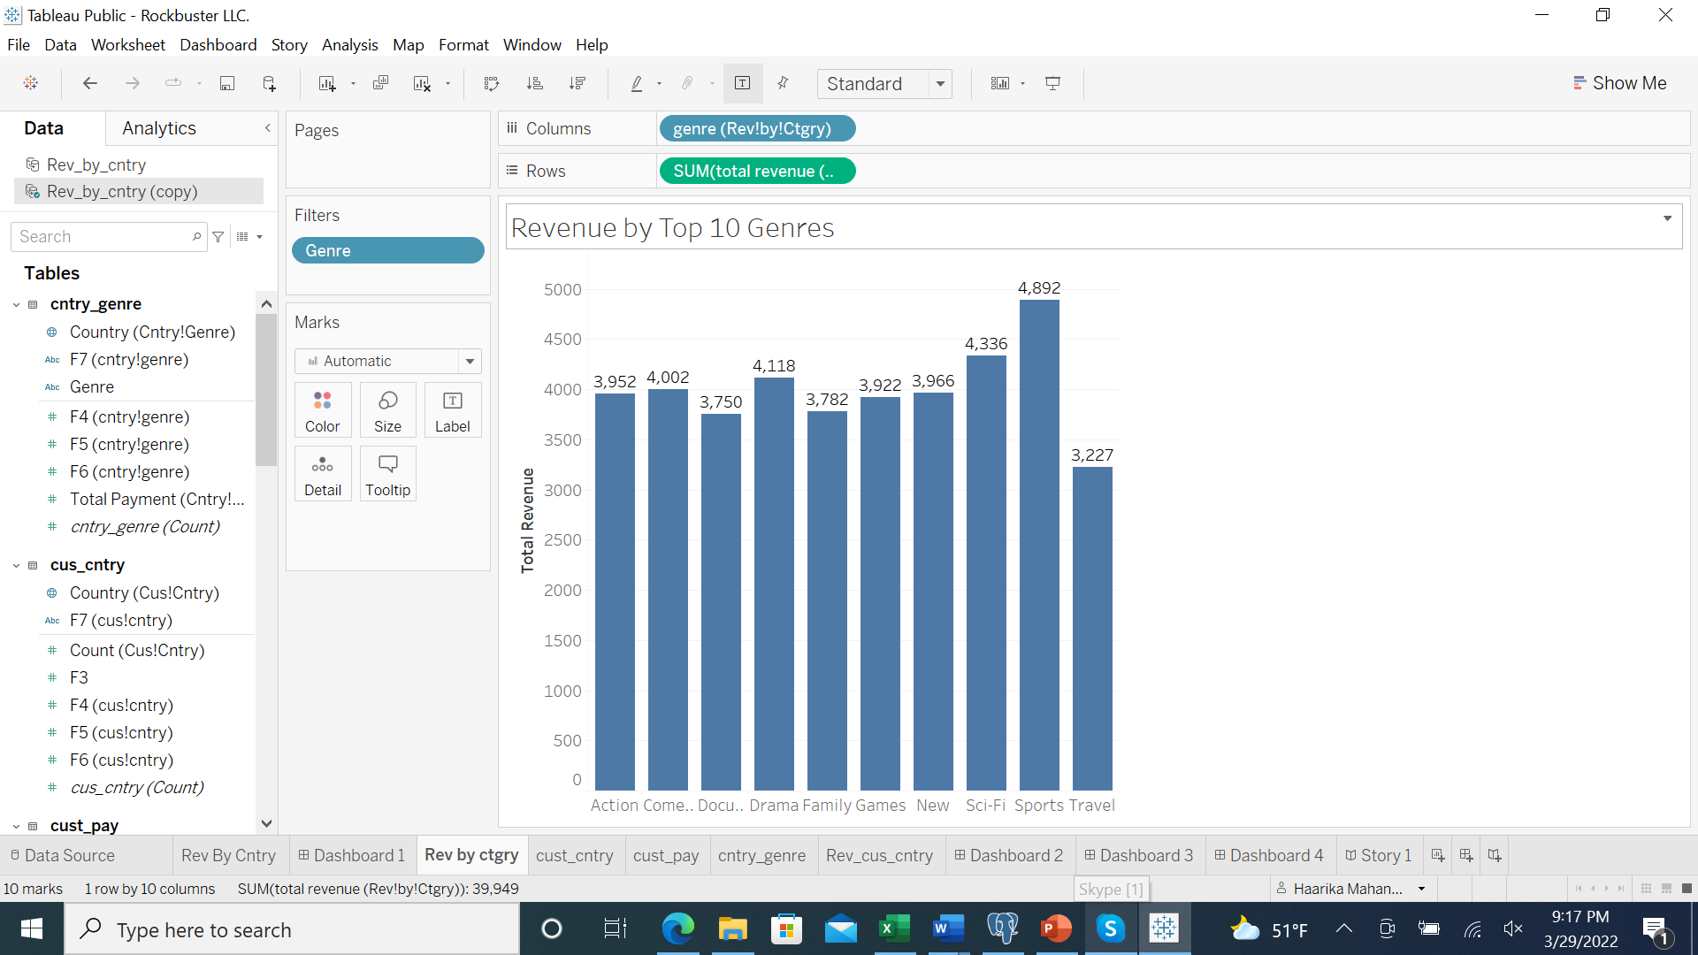
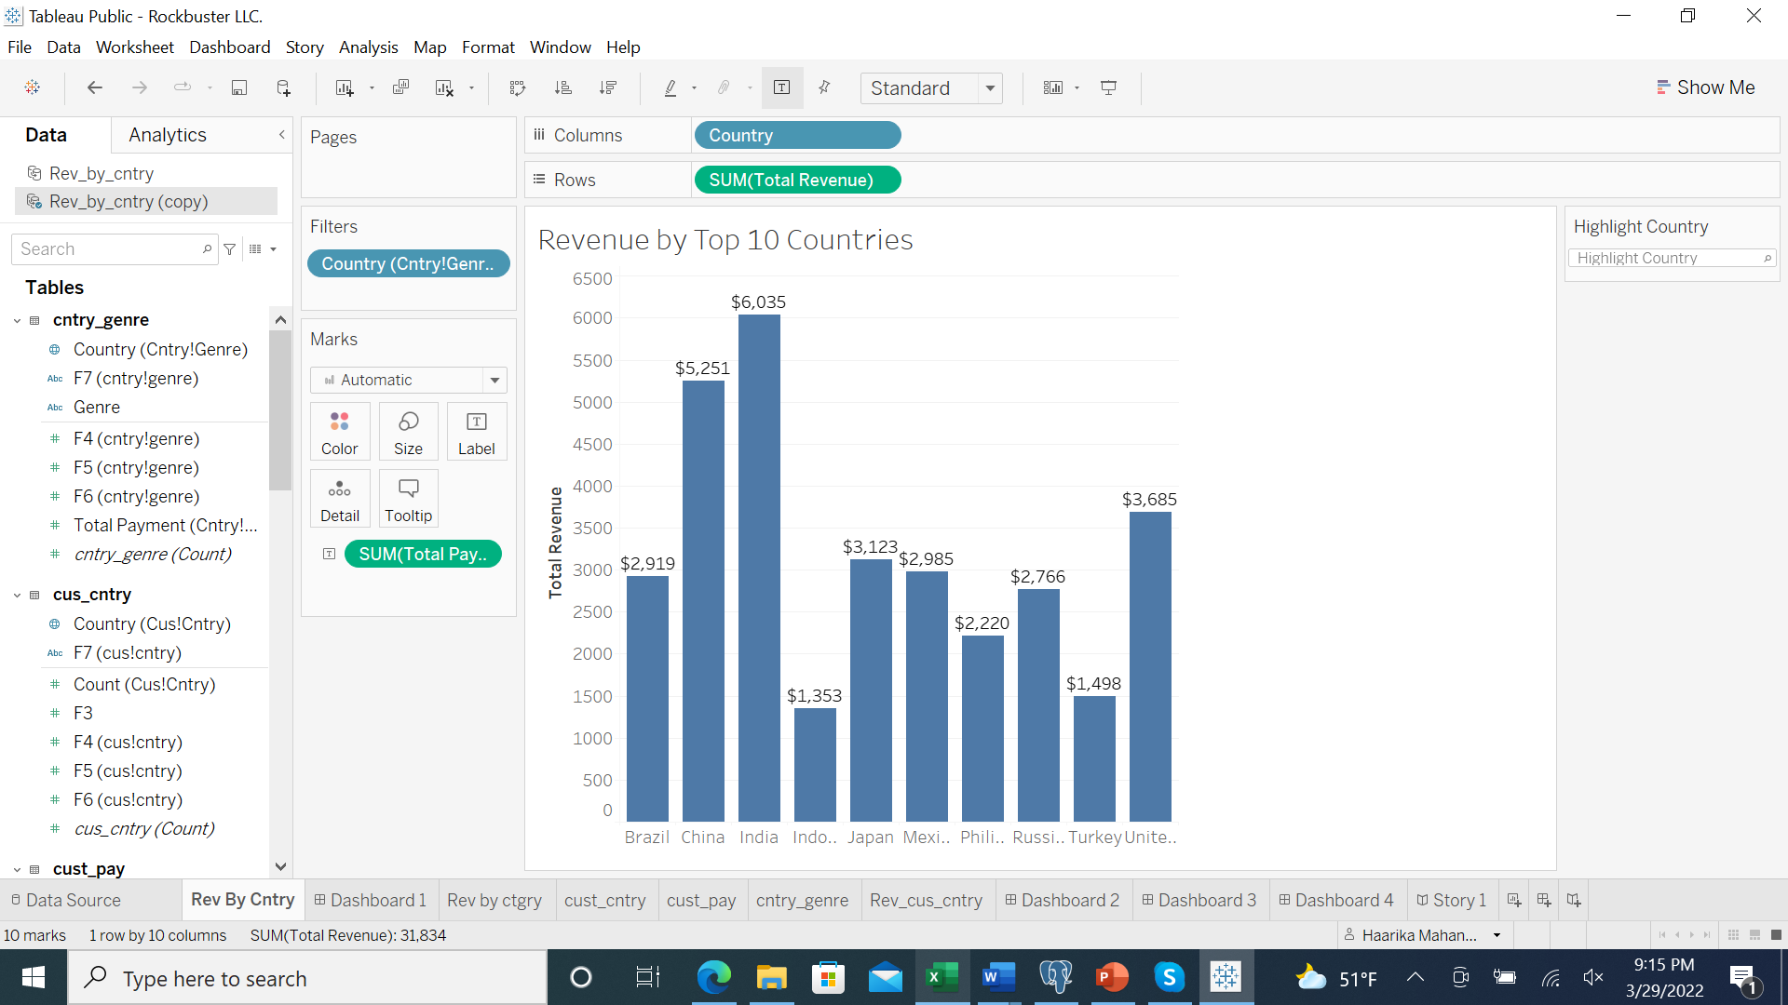
Revenue Division For the year 2006, Rockbuster Stealth has total revenue of $61,312.04
Among top 10 countries with highest revenue, India has highest with $6,035
Sports Genre has brought highest revenue of $4,892

Slide 8
Business Insights:
Since most of the customers are from Asia region, it would benefit Rockbuster Stealth to include movies from that region or offering existing movies in different languages.
Offering more movies in the high revenue generating genres to attract more customers
Emphasize more marketing and budget in the Asia region as it has higher customer base.
Valuing high performing customers to an early bird membership to streaming service.

Slide 9
Questions?

